Slide 1

Digging Deeper Neural Networks
Dr Chris McCool

Slide 2
Time | Presentation | Practical Session
12.45am – 2.45pm | Digging Deeper: Neural networks 1. Overview of NNs 2. Convolutional NNs 3. Deep learning | NN analysis in Python
2.45pm – 3.00pm | Break
3.00pm – 4.30pm | Extended topics: NNs NNs for 2D images | NN analysis in Python
4.30pm – 5.00pm | Extended topics: NNs Deep Learning Systems Concluding remarks: Day 2 | No prac.

Slide 3
Part II Convolutional Neural Networks (CNNs)

Slide 4
CNNs for Image Classification
Convolutional Neural Networks (CNNs) are important to understand for image classification
Exploit the use of local features
Learnt from the data rather than hand-crafted
Using “Deep” Convolutional Neural Networks (DCNNs) network provide state-of-the-art performance for numerous image-related tasks
Object detection/classifcation, face recognition
Image captioning, semantic segmentation

Slide 5

CNNs for Image Classification
If we vectorise an image we enforce a spatial relationship
Why would the bottom right of this image dictate what we expect to see in the top left?

Slide 6
CNNs for Image Classification
If we vectorise an image we enforce a spatial relationship
Why would the bottom right of this image dictate what we expect to see in the top left?

Slide 7
CNNs for Image Classification
If we vectorise an image we enforce a spatial relationship
Why would the bottom right of this image dictate what we expect to see in the top left?
Solution: extract local features
Robust to illumination, scale and rotation variations
Do we learn a local feature for each region?
How can we make them descriptive enough to get the information we want?

Slide 8
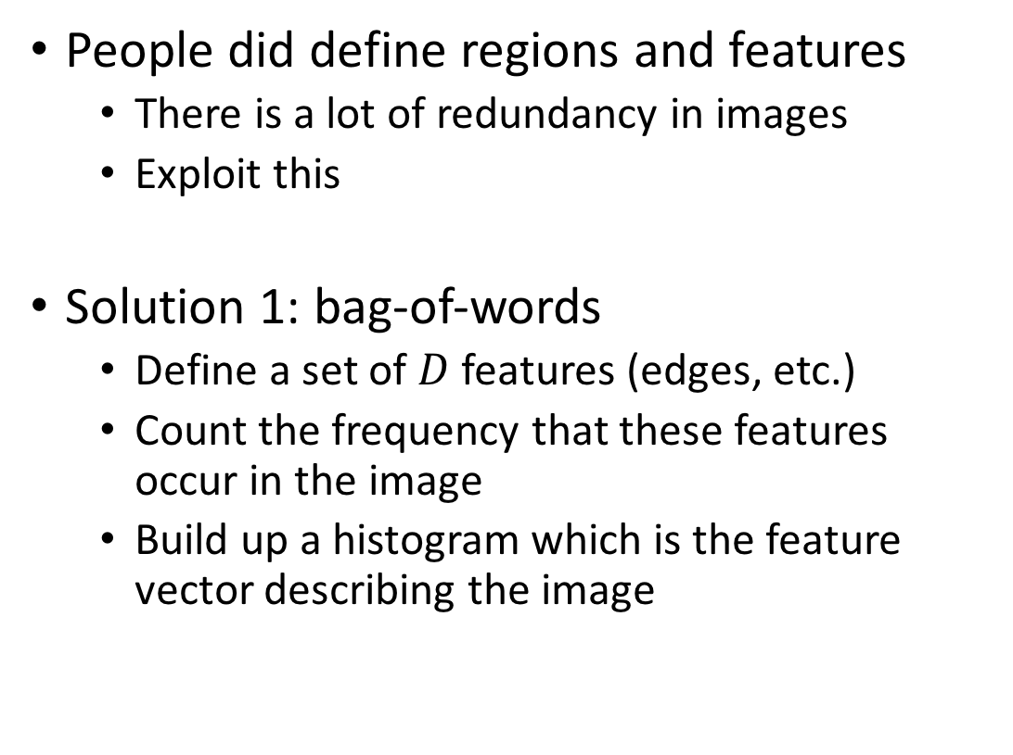
CNNs for Image Classification
People did define regions and features
There is a lot of redundancy in images
Exploit this
Solution 1: bag-of-words
Define a set of $D$ features (edges, etc.)
Count the frequency that these features occur in the image
Build up a histogram which is the feature vector describing the image
v₁
v₂
v_{D}

Slide 9
CNNs for Image Classification
People did define regions and learnt features
There is a lot of redundancy in images
Exploit this
Solution 2: convolutional neural network
Extract the same kind of features from a sliding window
CNNs provide a framework to learn the “features” from the data

Slide 10


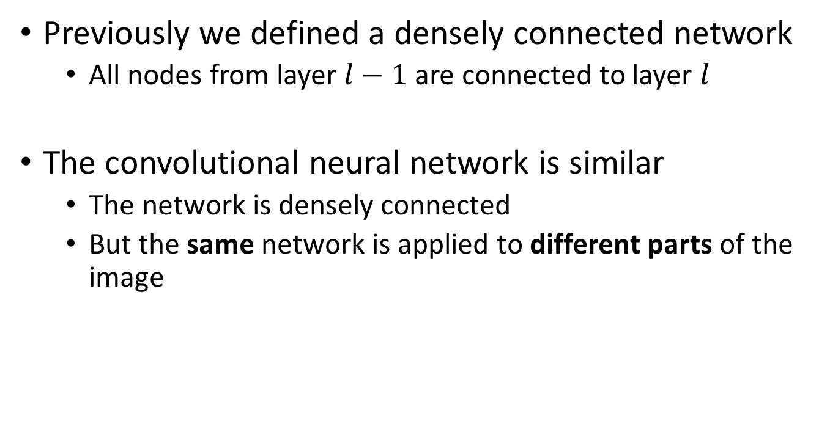
CNNs for Image Classification
Previously we defined a densely connected network
All nodes from layer $l−1$ are connected to layer $l$
The convolutional neural network is similar
The network is densely connected
But the same network is applied to different parts of the image
$$l−1$$
a₁₁
$$l$$
a₂₁
a₁₂
a₂₂
a₁₃
a₂₃
a₁₄

Slide 11
CNNs for Image Classification
Convolutional Network
The output is a filter that is applied to the input (e.g. sliding window)
Learns a transform to convert the 3x3x1 to a vector of size D₁
3x3 region
D₁ channels (filters)
Input Image (28x28)
1 channel

Slide 12
CNNs for Image Classification
Convolutional Network
The output is a filter that is applied to the input (e.g. sliding window)
Learns a transform to convert the 3x3x1 to a vector of size D₁
D₁ outputs
3x3 Image Region

Slide 13
CNNs for Image Classification
Convolutional Network
The same filters/network is applied to different parts of the image
Exploits redundancy in images
The filters/network is learnt from data
Acts as a regularisation for the learnt features
D₁ outputs
3x3 Image Region

Slide 14
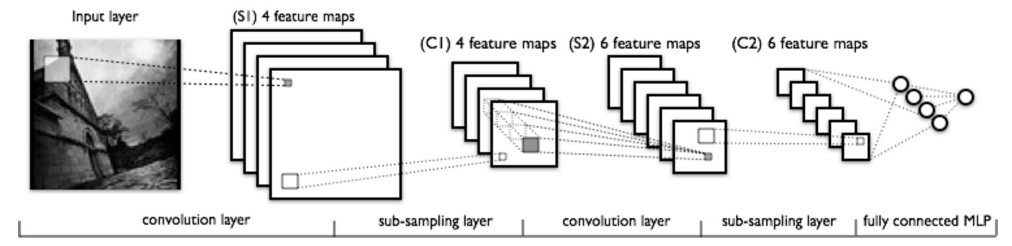
Deep CNNs for Image Classification
Deep CNNs
Stack convolutional layers together
Overcomes a major limitation of bag-of-words
Defining the filters and doing so at multiple levels
Image from: http://deeplearning.net/tutorial/lenet.html

Slide 15
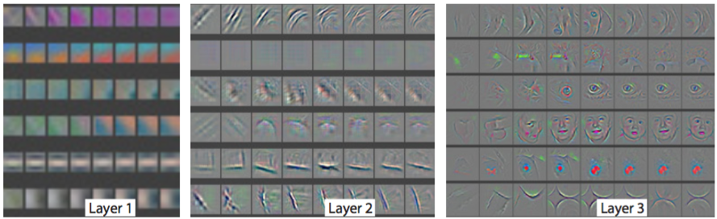
Deep CNNs for Image Classification
Features are learnt from data
Represent more complicated/abstract concepts at deeper layers
“Visualizing and Understanding Convolutional Networks”, M. Zeiler and R. Fergus

Slide 16
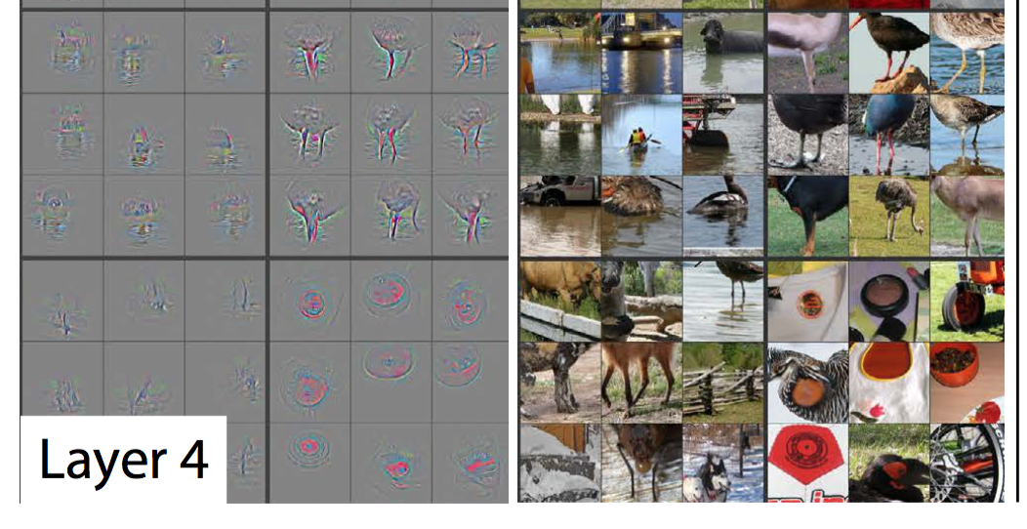
Deep CNNs for Image Classification
“Visualizing and Understanding Convolutional Networks”, M. Zeiler and R. Fergus

Slide 17
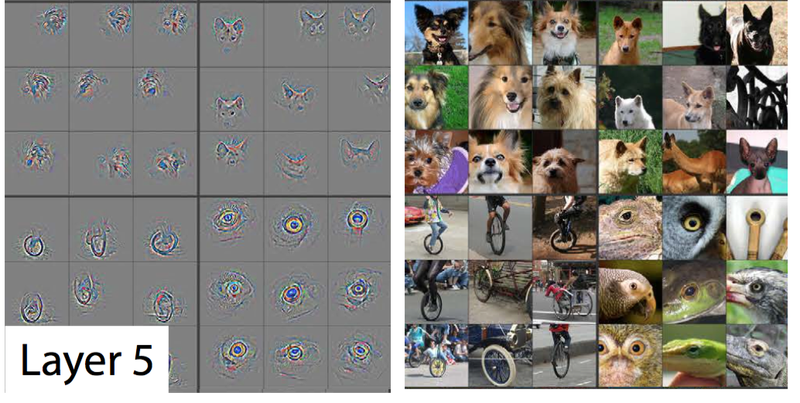
Deep CNNs for Image Classification
“Visualizing and Understanding Convolutional Networks”, M. Zeiler and R. Fergus

Slide 18
CNN Building Blocks
Convolutional filters
Number of nodes/filters
How complicated the filter is
Stride
How many pixels they move before being re-applied
Kernel
Area of interest

Slide 19
CNN Building Blocks
Strides for convolutional filters
7x7 Input Volume
3x3 Output Volume

Slide 20
CNN Building Blocks
Kernel size

Slide 21

CNN Building Blocks
Stride
Kernel size
Image size

Slide 22
CNN Building Blocks
Stride
Kernel size
Image size

Slide 23
CNN Building Blocks
Pooling Layers
Take the average or maximum of a region
Provides some robustness to translations, rotations, scale, etc.
Reduce the complexity by down-sampling “feature maps”
Feature map 1
Feature map 2

Slide 24
CNN Building Blocks
Pooling Layers
Take the average or maximum of a region
Provides some robustness to translations, rotations, scale, etc.
Reduce the complexity by down-sampling “feature maps”
Single Depth Slice
1 | 1 | 2 | 4
5 | 6 | 7 | 8
3 | 2 | 1 | 0
1 | 2 | 3 | 4
max pool with 2x2 filters
6 | 8
3 | 4

Slide 25

CNN Building Blocks
VGG16

Slide 26
CNN Building Blocks
Some useful rules of thumb
Kernel size
Stacking 3x3 convolutions
Stride
Usually 1x1
Followed by pooling (usually max pooling)
2x2, this often the down-sampling layer
Image size
Application dependent but bigger is usually better
Data
More is better

Slide 27
CNN Building Blocks
Diagrams for CNNs
Size of a feature map usually indicates the amount of downsampling
The depth is indicative of the number of features
Also, there are usually dense or fully connected layers (FC layers)

Slide 28
CNN Building Blocks
Fully Connected Layers (FC layers)
Like a standard NN
Are often the interface between the last convolutional map
3
3x3xD
3
D

Slide 29
Building Your First Convolutional Neural Network
Notes:
It probably takes about 30 minutes to get to this point!

Slide 30
Building Your First CNN
Let’s build upon the first NN from the previous part
We’ll learn some convolutional filters (neural networks)

Slide 31
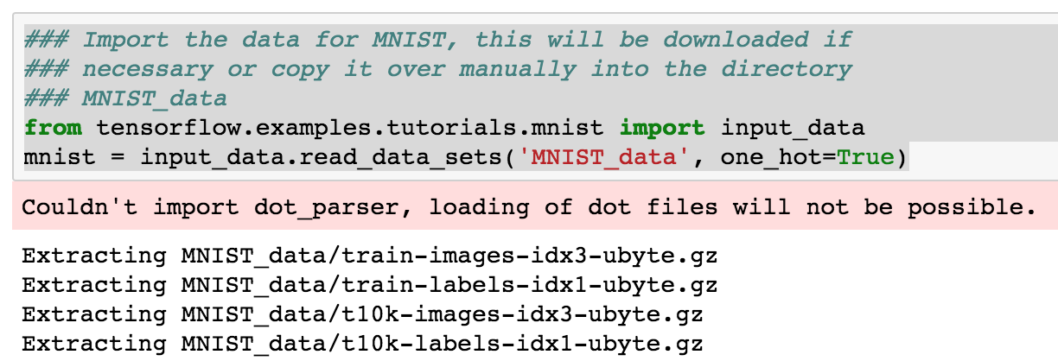
Building Your First DCNN
Getting the data ready. As before we’re doing classification.

Slide 32
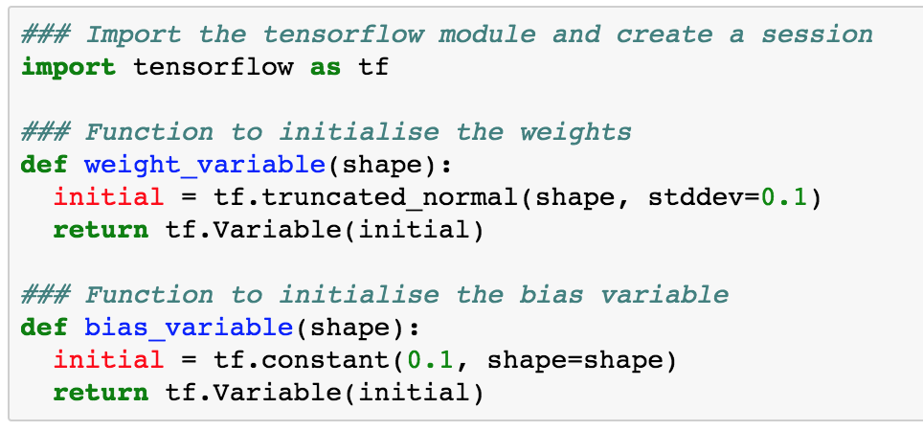
Building Your First DCNN
We’ll define some helper functions

Slide 33
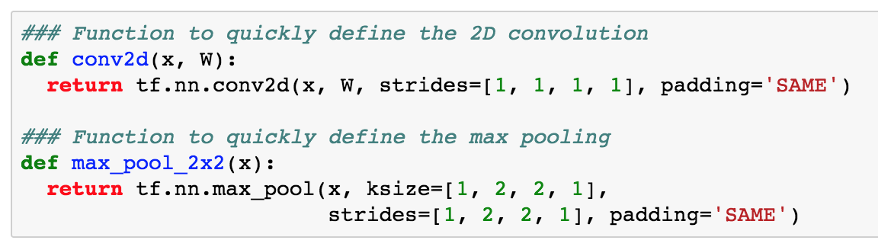
Building Your First DCNN
The following let’s us apply the 2D convolutions and max pooling quickly

Slide 34
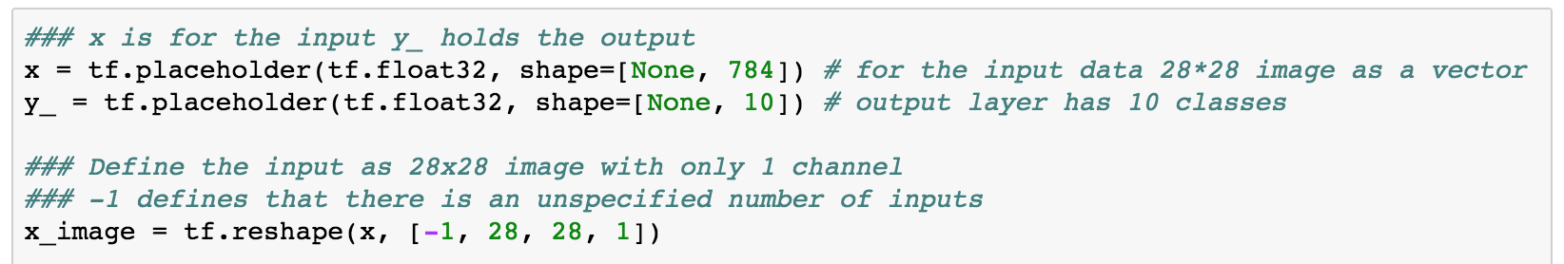
Building Your First DCNN
Let’s prepare our data, converting from the 784 vector to 28x28
x₁
x₂
x_{D}

Slide 35
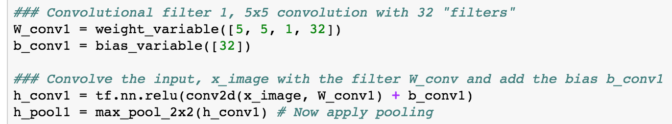
Building Your First DCNN
1st convolutional layer
32 filters, region size is 5x5

Slide 36
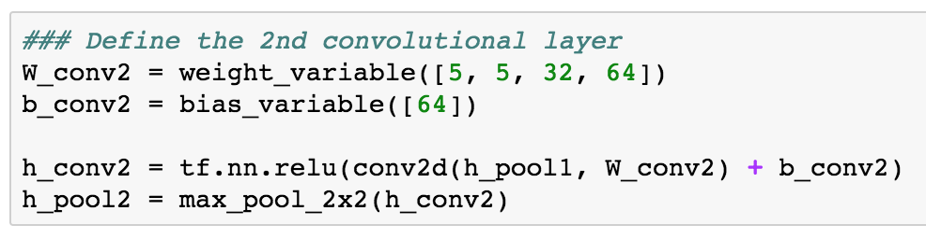
Building Your First DCNN
2nd convolutional layer
64 filters, region size is 5x5

Slide 37
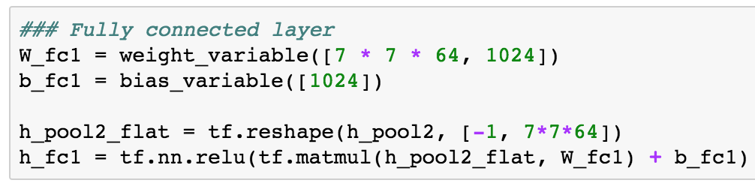
Building Your First DCNN
One fully connected layer (regular or dense NN layer)
1024 hidden nodes
7x7 is the feature map size
7
7x7xD
7
D

Slide 38
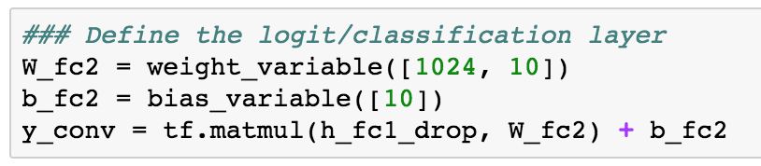
Building Your First DCNN
Add “dropout” to the fully or densely connected layer
Helps with regularisation and avoiding overfitting
10 is the number of classes (digits 0-9)

Slide 39
DCNNs for Image Classification
Dropout during training
At each iteration randomly remove nodes
Enforces robustness
Often applied to dense layers of a network
What about convolutional layers?

Slide 40
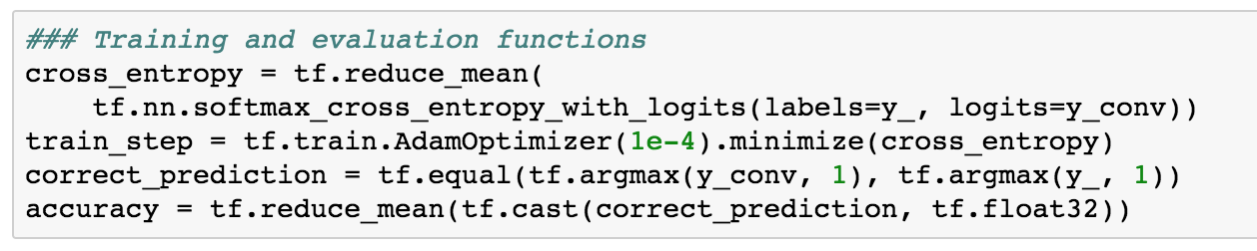
Building Your First DCNN
Add the loss as before, training using AdamOptimizer
Quicker and more suitable for this task
Also add in how to estimate the accuracy of the system

Slide 41
Building Your First DCNN
AdamOptimizer
Quicker and more suitable for this task
Adapts the parameter learning rates adaptively using first and second order moments

Slide 42
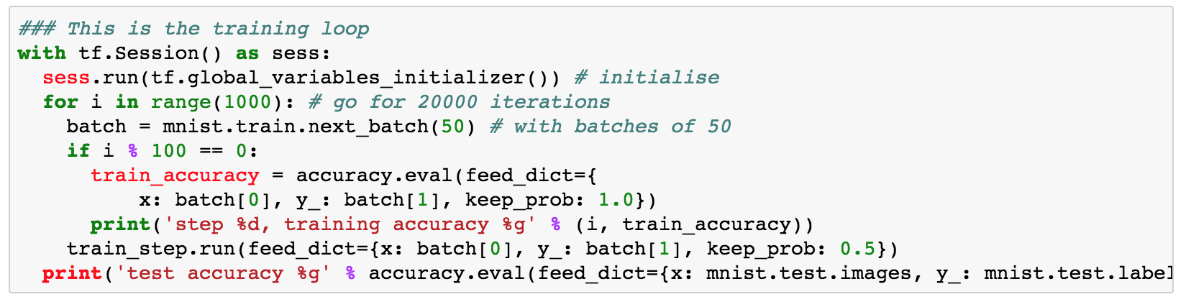
Building Your First DCNN
The training loop…

Slide 43
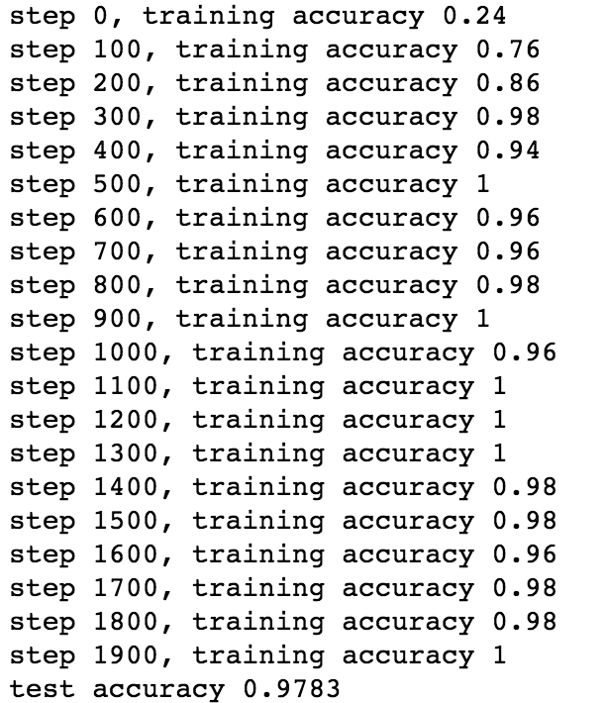
Building Your First DCNN
Let’s train it and then test it
The code for this is here
ABS_PartII_CNN.ipynb
Let’s add another convolutional layer
Notes:
Another 15 minutes to get here. And that’s close to the end of the first 2 hour session without any break.

Slide 44
Going Even Deeper

Slide 45
DCNNs for Image Classification
Multitude of Network Structures
Deep due to their many layers
Basic idea is multiple convolutional layers
Followed by some dense (fully-connected layers)
Came about (for images) due to 3 main improvements
Graphical processing units (GPUs)
Efficient to compute non-linearities (e.g. ReLU)
Regularisation using Dropout
and a lot of labelled data…

Slide 46
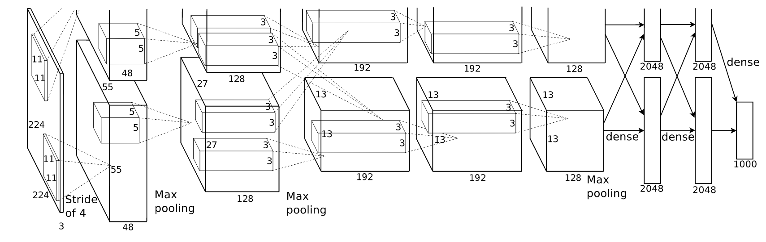
CNNs for Image Classification
AlexNet

Slide 47
CNNs for Image Classification
VGG16

Slide 48
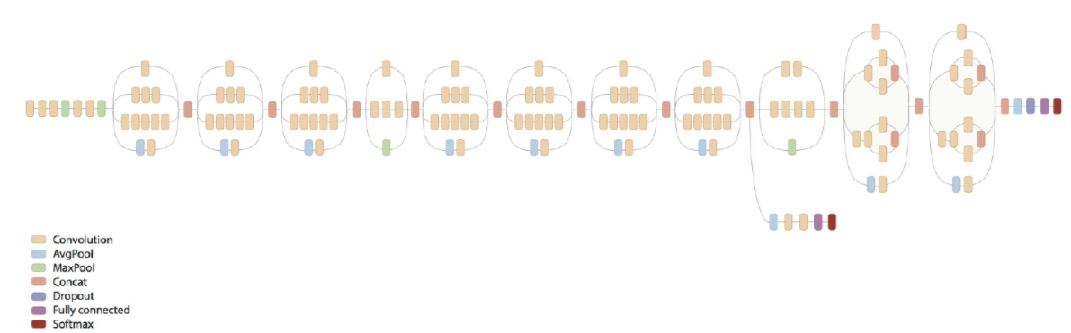
CNNs for Image Classification
Inception

Slide 49
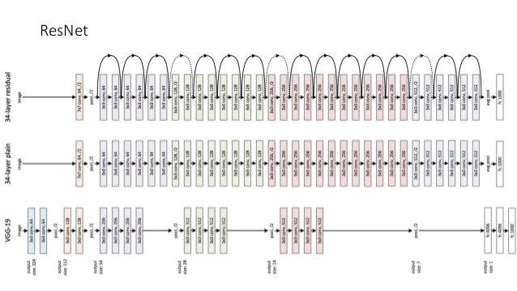
CNNs for Image Classification

Slide 50
More on CNNs for Image Classification
Going even further please look at this tutorial
https://www.tensorflow.org/tutorials/deep_cnn
Other noramlisation approaches
Local response normalisation
Data augmentation
Flipping images, adding random noise to the training data, etc.
Learning rate schedule
Queuing data for efficient training
Using multiple GPUs
Order(s) of magnitude more efficient than CPUs

Slide 51
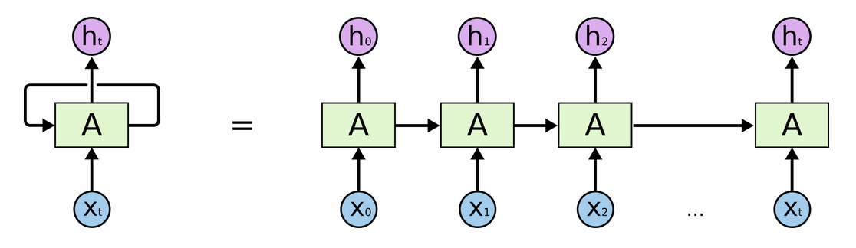
Introduction to Recurrent Neural Networks
A network with feedback loops
Allows information to persist
Can be considered as any networks tied together

Slide 52
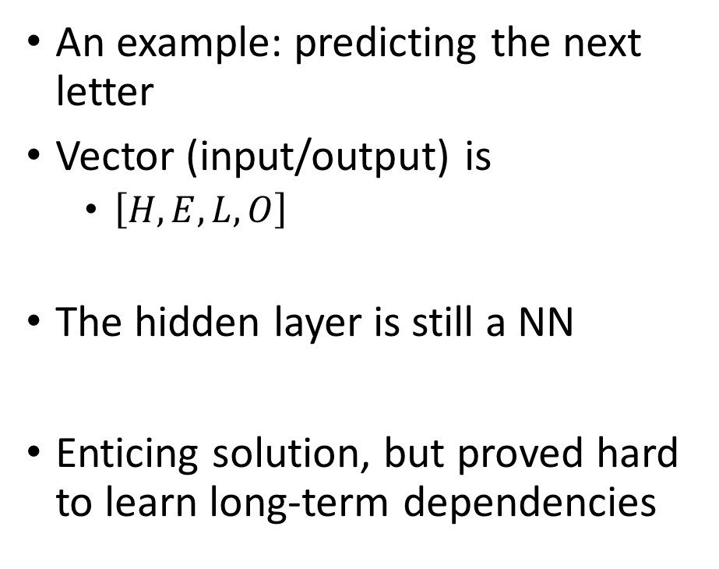
Recurrent Neural Networks
e
l
l
o
An example: predicting the next letter
Vector (input/output) is
$\left[H,E,L,O\right]$
The hidden layer is still a NN
Enticing solution, but proved hard to learn long-term dependencies
1.2
2.6
-2.3
3.1
0.6
0.2
1.1
1.0
0.1
0.5
1.8
-0.9
0.2
-0.9
-0.3
2.1
Output
0.8
-0.3
1.2
1.1
0.2
-0.2
0.5
-1.4
-0.9
-0.6
1.3
0.2
Hidden
1
0
0
0
0
1
0
0
0
0
1
0
0
0
1
0
Input
h
e
l
l

Slide 53
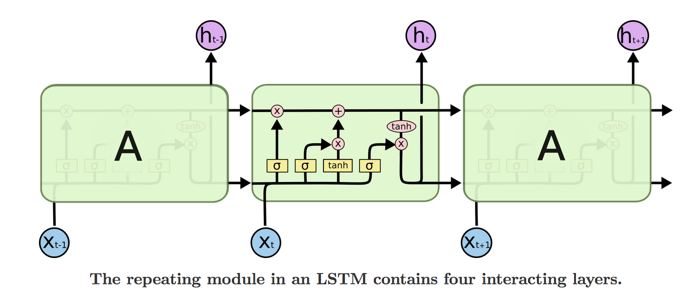
Recurrent Neural Networks
Digging deeper
Most RNNs use a framework called an LSTM
Long Short Term Memory
Both long- and short-term memory
http://colah.github.io/posts/2015-08-Understanding-LSTMs/

Slide 54
Recurrent Neural Networks
RNNs
Long-term memory is the top line
The first connection enable the system to forget
The second connection enables adding to the long-term memory
We then update the long-term memory
Finally we output the current state

Slide 55
Introduction to Recurrent Neural Networks
Multiple variants of this exist
Peephole connections
Gated recurrent unit

Slide 56
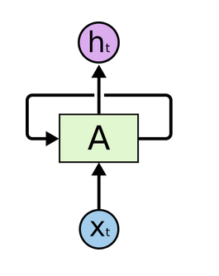
Recurrent Neural Networks
Example code in TensorFlow
python ptb_word_lm.py --data_path=./data/simple-examples/data/ --model=small
https://www.tensorflow.org/tutorials/recurrent
Further background information here:
http://colah.github.io/posts/2015-08-Understanding-LSTMs/

Slide 57
Recap
Discussed Convolutional Neural Networks
Basis for using convolutions
Coded up and trained two CNNs
Motivation for using Deep CNNs
More advanced architectures
Brief Introduction to Recurrent Neural Networks (RNNs)

